Slide 1
First Responders & Hemophilia
MISSION
The Hemophilia Federation of America (HFA) is a national nonprofit organization that assists and advocates for the bleeding disorders community.
[Your Name]
[Your Address]
© 2015 Hemophilia Federation of America. All rights reserved.
Session Titles, Descriptions & Content are copyrighted material belonging to the Hemophilia Federation of America.
Notes:
This presentation is customizable for you or your child. It is can be used as an educational in-service for your local first responders – fire department, emergency medical services and law enforcement. It is intended to be given as a presentation, but printing this out for each attendee of an in-service meeting is ideal.
Delete this slide before presenting
Anywhere you see {insert your/child’s name – or other text in brackets} highlight the words and brackets and type your/your child’s name or pertinent information
Insert photos of you/your child throughout. The more personal you can make this presentation, the more impact it has on personnel
Check the notes section for presentation notes and other tips for slides

Slide 2
Objectives
Understand the basics of hemophilia and characteristics of a bleed
Understand what to do in case of an emergency with a person living with hemophilia

Slide 3
Definition of Bleeding Disorders
A group of hereditary bleeding disorders in which there is a deficiency of one of the factors necessary for coagulation of blood.
Notes:
Does anyone know someone who’s living with a bleeding disorder?

Slide 4
Types of Hemophilia
Hemophilia A - absence or deficiency of FVIII; also known as Classic Hemophilia
Hemophilia B - absence or deficiency of FIX; also known as Christmas Disease
{Insert patient’s name} has Hemophilia ___
Other rare missing clotting factors can include factors II, V, VII, X, XI, XIII.
Notes:
When you tell the audience about

Slide 5
People with hemophilia bleed longer, not faster.
Notes:
Hemophiliacs are missing, or have low levels, of a clotting factor – this makes it difficult for the blood to form a clot.
In people without hemophilia (the top picture), all the clotting proteins lined up to work together to form a clot.
In person with hemophilia (the bottom picture), one of the clotting proteins is missing or incomplete. The clotting process begins, but a person with hemophilia is unable to form a stable clot. This doesn’t mean they bleed faster – just that they bleed longer.

Slide 6
Notes:
Here is a graph of the inheritance patter of Hemophilia.
Mother is the carrier, 50% chance sons will have hemophilia, daughter will be a carrier.
There can be spontaneous mutations.
Discuss your personal experience. Does hemophilia run in your family, or was it a mutation?

Slide 7
Incidence of Hemophilia
One in 7500 live male births
Affects approximately 17,000 males in the U.S.
All races and socioeconomic groups are equally affected
X-linked disorder, females carry gene, males are affected. 30% cases genetic mutations
Notes:
One in 7500 live male births
Affects approximately 17,000 males in the U.S.
All races and socioeconomic groups are equally affected
X-linked disorder, females carry gene, males are affected
30% cases genetic mutations

Slide 8
Degrees of Severity
Normal factor VIII or IX level = 50-150%
Mild hemophilia - factor VIII or IX level = 6-50%
Moderate hemophilia - factor VIII or IX level = 1-5%
Severe hemophilia - factor VIII or IX level = <1%
{Insert patient’s name} has severe hemophilia

Slide 9
Types of Bleeds
Joint bleeding
Muscle hemorrhage
Soft tissue - bruising
Life threatening bleeding
Others - mouth, nose, scrapes, minor cuts

Slide 10
.
Notes:
Someone with a bleeding disorder can feel a joint bleed LONG before anyone sees any outward symptoms
Early signs of joint bleeding include:
bubbling
tingling
heat at the joint
Swelling and pain
This is the best time to start treatment
As the joint swells, it feels boggy, and range of motion is limited
May not be able to bear weight or move a limb
Very painful in later stages of a bleed
KEY POINT: Child can feel a joint bleed LONG before anyone sees any outward symptoms.

Slide 11
Joint Bleeding
Photo Credit: National Hemophilia Foundation

Slide 12
Muscle Bleeding
Signs and symptoms similar to joint bleeding
can include tightness
shininess of skin
is very painful
usually happens in the arms and legs
swelling
Significant blood loss can happen quickly
Notes:
Muscle bleeding is the second most frequent site of bleeding.
Any area of the body can be affected but frequently the extremities are involved. Large muscle bleeding can lead to nerve compression (i.e. iliopsoas, thigh - see picture). Significant blood loss can occur in large muscles before appreciable swelling is evident.
Bleeding into small muscles can also cause compartment syndrome (i.e. forearm, calf).
Signs and symptoms of muscle bleeding may include:
Vague ache or pain
Heat
Swelling
Inability/unwillingness to move muscle
Tightness of skin
Shininess in skin

Slide 13
Muscle Bleeding
Someone with a bleed can feel a muscle bleed LONG before anyone sees any outward symptoms.

Slide 14
Soft Tissue Bleeding
Primarily characterized by bruising and hematomas (raised bruises)
Many with hemophilia have bruises all over their bodies
Treatment is generally not needed, ice can help with comfort
Graphic Credit : Wilkes family
Notes:
This slide illustrates common soft tissue bleeds in children. The child in the picture has a soft tissue bleed following a peripheral venipuncture. Applying firm pressure to a venipuncture site for several minutes will help prevent bleeding.
Bruises and hematomas are very common. Treatment is generally not required. Ice is often very effective.

Slide 15
Life-Threatening Bleeding
Head/Intracranial
Nausea, vomiting, headache, drowsiness, confusion, visual changes, loss of consciousness
Neck and Throat
Pain, swelling, difficulty breathing/swallowing
Abdominal/GI
Pain, tenderness, swelling, blood in the stools
Iliopsoas Muscle
Back pain, thigh tingling/numbness, decreased hip range of motion
Notes:
Head/Intracranial
Nausea, vomiting, headache, drowsiness, confusion, visual changes, loss of consciousness
Neck and Throat
Pain, swelling, difficulty breathing/swallowing
Abdominal/GI
Pain, tenderness, swelling, blood in the stools
Iliopsoas Muscle
Back pain, thigh tingling/numbness, decreased hip range of motion

Slide 16
Other Bleeding Episodes
Mouth bleeding
Looks like more than it is, as it is mixed with saliva
Child may vomit
Feces may be black (from swallowed blood)
Nose bleeding
Sit up, pinch bridge of nose, cool pack on back of neck
If longer than 20 minutes, a trip to ER may be required
Scrapes and/or minor cuts
Wash, pressure, dressing
Call parents if bleeding persists

Slide 17
Treatment of Bleeding Episodes
Early and appropriate treatment of each bleeding episode is critical to minimize complications.
REPLACEMENT OF DEFICIENT CLOTTING FACTOR IS THE SINGLE MOST IMPORTANT STEP IN
ANY INTERVENTION

Slide 18
Factor Administration
Factor concentrate is administered intravenously (IV)
It should be administered as close to the time of the bleed as possible

Slide 19
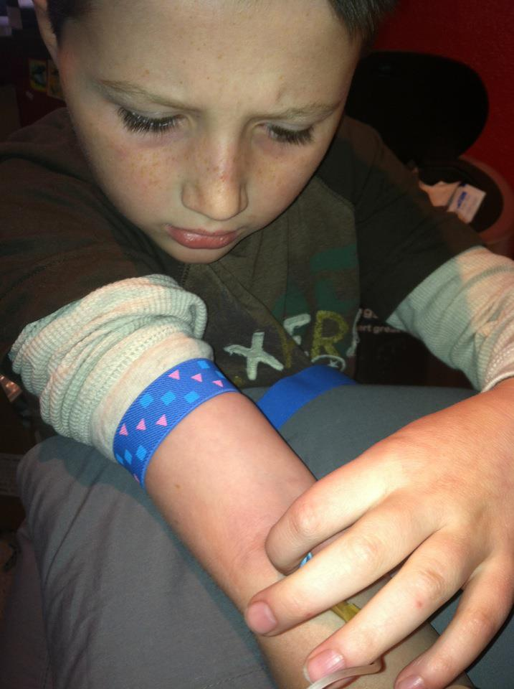
Factor Administration
In {insert patient’s name}, factor is administered through {port or through a peripheral stick in his arm}
Factor is kept {insert location in your home} and should accompany {insert patient’s name} if transported to the hospital

Slide 20
In an Emergency Setting
Notify the appropriate medical staff locally
Tell your local first responders to flag home and address as a precaution
Create an emergency plan and complete any necessary documentation

Slide 21
Things to Know
Patient may have excessive bruising
Some older bruises may become lumpy or hard
Patient may have port accessed
Needle inserted into his port
Will be covered by tape and his clothing
Medication is kept in {insert where medication is located in your home}

Slide 22
Meet {Insert Your/Child’s Name}
Age
LIST DIAGNOSIS i.e. Has severe Hemophilia A with a history of an inhibitor
LIST HOW FACTOR IS GIVEN i.e. Has a port – venous access to infuse factor
Developmentally on target
Notes:
Customize this slide about you/your child!!! Add photos on the right hand side!
May want to mention your child’s factor schedule (i.e. “Little Johnny infuses on Monday, Wednesday, Friday and takes ___ units/kilo of factor VIII or IX via IV push. Parents normally infuse Little Johnny before school on those mornings.” )

Slide 23
Summary
Hemophilia patients know his/her own body and are experts about their condition.
Have an emergency plan in place for those with bleeding disorders.
Be proactive!

Slide 24
© 2015 Hemophilia Federation of America. All rights reserved.
Session Titles, Descriptions & Content are copyrighted material belonging to the Hemophilia Federation of America.
Notes:
Invitation to get involved:
Advocacy
Social media
Local sessions
Symposium
Etc…
It's up to you to ask questions with your HTC/chapter/member org/HFA, show up to events (be involved), and take action when a legislative action alert is sent out.

Slide 25
Thank You!
Contact us:
hfaprograms@hemophiliafed.org
info@hemophiliafed.org

