Slide 1
This presentation is customizable for your child. It is can be used as an educational in-service for teachers and school personnel. It is intended to be given as a presentation, but printing this out for each attendee of an in-service meeting is ideal. You can also ask that a copy of this presentation in kept in your child’s permanent file, in the nurse’s office and in your child’s classroom. One mother even asked that the teacher keep a copy in her folder for any substitute teachers.
Delete this slide before use at your school
Anywhere you see {insert child’s name – or other text in brackets} highlight the words and brackets and type your child’s name or pertinent information
Insert photos of your child throughout. The more personal you can make this presentation, the more impact it has on school personnel
Check the notes section for presentation notes and other tips for slides

Slide 2
von Willebrand Disease (vWD) & (Insert Your Child’s Name)
At School

Slide 3
Meet {Insert Child’s Name}
Age
List siblings, names, ages, grade or school names
{Insert Child’s Name and LIST DIAGNOSIS} i.e. Has Type IIvWD
{LIST HOW FACTOR IS GIVEN} i.e. Has a port – venous access to infuse factor/orally/nasal spray
Developmentally on target
{Add photo of your child here}
Notes:
Customize this slide about your child!!! Add photos on the right hand side!
May want to mention your child’s factor schedule (i.e. “Little Johnny infuses on Monday, Wednesday, Friday and takes ___ units/kilo of factor VIII or IX via IV push. Parents will infuse Little Johnny before school on those mornings.” )

Slide 4
Definition of Bleeding Disorders
A group of hereditary bleeding disorders in which there is a deficiency of one of the factors necessary for coagulation of blood.
Notes:
Does anyone know someone who’s living with a bleeding disorder?
Today we are specifically discussing Hemophilia
Von Willebrand Disease affects males and females equally. However, because symptoms can be mild, many people affected have not been diagnosed. People with VWD have decreased or malfunctioning Von Willebrand factor (VWF) activity and therefore cannot form a proper platelet plug.

Slide 5
Did you know?
von Willebrand Disease is the most common type of bleeding disorder, affecting an estimated 1% of the world's population.

Slide 6
People with von Willebrand Disease bleed longer, not faster.
Notes:
People with von Willibrands Disease are missing, or have low levels, of a clotting factor – this makes it difficult for the blood to form a clot.

Slide 7
Degrees of Severity
{Insert patient’s name} has ___ vWD
Type of vWD | Severity
Type I | Symptoms are usually mild
Type II | Symptoms are usually moderate
Type III | Symptoms are usually severe
Notes:
Bleeding can be mild, moderate or severe within each type of vWD. The severity depends in part on the level of VW factor activity. Blood type plays a role in the levels of VW factor found in the blood. Type O blood often has lower levels of VW factor.

Slide 8
Notes:
Explain that you will discuss each of these kinds of bleeds in detail.

Slide 9
What Does This Mean in the School Setting?
All adults in contact with {insert Child’s name} should be aware that there is a child with vWD under their supervision
A care plan should be made with the medical staff, school personnel and parents
Parents will make sure this is in place with nurse
Key people should be made aware of the plan

Slide 10
Things to Expect
vWD is unpredictable!
May be covered in excessive bruising
Some older bruises may become lumpy or hard
May come to school “accessed”
Needle inserted into his port
Will be covered by tape and his clothing
May come to school wrapped in ACE bandage or Coban, or other device
Medication will be kept in nurse’s office
Notes:
Insert pictures on right hand side – maybe of your child in some of these situations – ACE Bandage, with bruises, etc.
It’s possible he may missed school due to bleeding episodes. The parents agree to communicate with school to facilitate make up work, etc.
He may also come to school using assistive devices. It’s possible he could be in a wheelchair, on crutches, etc.

Slide 11
When to Call Parents or Nurse
If {insert child’s name} says something hurts
Remember, the child can feel a bleed before there are any outward signs
Injury to joints
ANY head or neck injury
Non use of a limb or swelling, warmth or redness in a limb
Injury to torso (especially chest wall) or kidney area
Notes:
If your child has a port, stress that it’s extremely important to call the parents immediately. A fever is a sign of a possible port infection which can be life threatening. Fevers must be thoroughly checked with blood culture to determine the cause of the fever.
Be sure to note: The parents will ask questions to determine how a bleeding episode started or how the injury occurred. Do not mistake this questioning as blaming – it’s only so the parents can help the medical providers determine the best course of treatment.

Slide 12
Additional School Information
{insert child’s name} should not be treated differently than any other child in the classroom
Leave it up to the parents and/or the child to share with others that he has vWD
There are no learning disabilities that are associated with vWD
Child may have pain issues:
Could have acute or chronic pain
Medication side effects
Notes:
Add anything here that is specific to your child

Slide 13
Activities
Unless recovering from a bleeding episode:
Should participate in regular gym class
Should go on all planned field trips
Should play at recess with classmates
Some activities restrictions:
No contact sports
May need immobilization during or after a bleed
May need some alternative activities for inclusion in physical education, recess, etc.
Notes:
Can play along with other kids and do the same activities as others
Pay careful attention at recess & PE
No rough-housing with other kids
Does not have to wear helmet as of now
No jumping off equipment
Use equipment properly (no going up the slide, don’t come head first down slide, no jumping off play-sets, etc.)
Customize to your comfort level; items listed are only intended as examples from other parents.
Prefer that he not be excluded from activities, but intergraded in other manners. For example, he shouldn’t play dodgeball, but he can be the “watch” and help spot others who are tagged out.

Slide 14
How Much Do Other Adults Need to Know?
If other parents ask about {insert child’s name}, they can be told:
He/she has a medical condition
He/she has von Willebrand Disease
He/she has a bleeding disorder
Encourage them to talk us if they have more questions. We welcome the opportunity to give them more information.
Notes:
You have to decide what’s right for your family in terms of disclosure to persons other than school personnel (other parents and students). If you or your child are not comfortable disclosing to others, you can delete this slide.

Slide 15
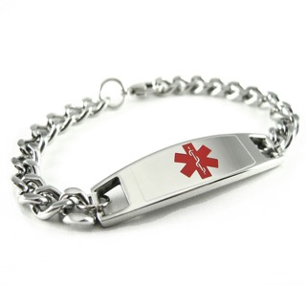
How Much Do Other Children Need to Know?
If other kids notice bruising, helmet, Medic-Alert bracelet:
{Insert Child’s Name} can tell the other kids :
“I have special blood”
“My blood doesn’t work right”
“I’m missing something in my blood”
“I get pokes”
“I get infusions”

Slide 16
Responsibilities
Student
Parent
Learn to communicate
Tell someone when they are bleeding
Do your schoolwork on time
Make the same amount of effort as someone without vWD
Communicate child’s condition, activity level & treatment
Help obtain makeup work
Help the child have a positive attitude about school
Work with school staff & nurse to develop a medical plan
School
Monitor student achievement & inform parents of any change to personality, performance
Communicate to parent/child any observable sign of a bleed
Stress the importance of completing assignments
Promote ability and success, not inability
Respect privacy and confidentiality

Slide 17
Summary
Please treat him/her like any other student
Don’t label
Don’t overprotect
Don’t exclude
Don’t overreact
Believe him/her if he/she says something hurts
CALL if you have any questions!
Notes:
Add any other concerns you have here

Slide 18
Conclusions
Remember that {insert child’s name} is a normal child who happens to have a bleeding disorder
If you have questions or have ANY questions, ANY time, call the parents!

Slide 19
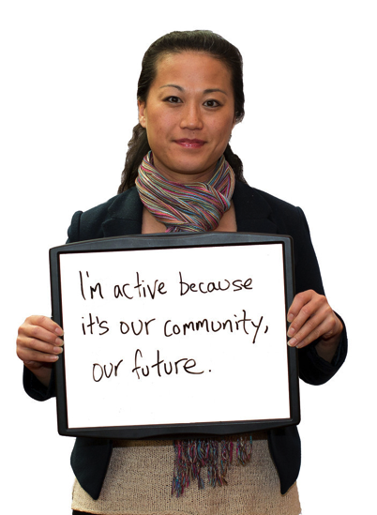
Thank You!
Contact us:
hfaprograms@hemophiliafed.org
info@hemophiliafed.org

